Slide 1
Assignment 1
Assignment 1

Slide 2

Assignment 1: To Understand - Observe and Interview
* Note: Each student please conduct interviews about your interested group to understand their pain points. Please follow the guidelines carefully and fill the information in the box in each step. (Be concise. Feel free to expand the box size if you need more space.)
Interested area
Your Name | CHAN, Chun Hin
Interested Area | Engineering Education
Selected User Groups | University students studying engineering related major
1

Slide 3
Assignment 1: To Understand - Observe and Interview
Part 1a: Observe
Create an observation plan. Answer the following questions:
WHO TO OBSERVE?
What types of people do you want to observe in order to learn and get inspired?
WHERE TO OBSERVE?
Where can you observe your target users in the real world? (Be specific, not just “on campus”.)
WHAT THINGS TO WATCH FOR?
What are you curious to learn? What themes will you be looking for?
HKUST Undergraduate students (Year 2 to 4) who have a major in engineering discipline, and Year 1 undergraduate students who are from School of Engineering.
These students are the one who would, or have already receive quite a lot knowledge related to engineering in HKUST. As HKUST School of Engineering is the biggest engineering school among all local universities, observing them would be more representative and give a better overview of local engineering education. Although HKUST says that the best engineering education is provided to students, plenty of engineering students think that it is not the case and they think many improvements can be done to the engineering education.
E2I Engineering Common, Library, Classrooms that are having engineering courses (lectures/tutorials/labs).
E2I Engineering Common: Many engineering students would stay in here to do the homeworks or do revision. Engineering student ambassadors may also appear here sometimes and they can be one of my interview targets as they may share their learning experience of the engineering courses they have tried.
Library: This is another popular place that engineering students would choose to study and do assignments. I can observe how they response to the assignments and materials when they are alone or with their friends.
Classrooms that are having engineering courses: I can observe the learning environment, the participation rate of the students during the classes. I may even know what the students usually do during the classes.
I am very eager to know how the HKUST engineering students think about the engineering education in an overall view. Firstly, I will concentrate on the actual learning experience during a few of the HKUST engineering courses in the weekdays by randomly attending several engineering courses lecture. Then, during the interview, I will be focusing on the engineering students’ opinions and feelings about the design of the engineering courses, the resources that the tutorials and the labs can provide. In addition, I will try to get their overall point of view towards the teaching assistants and the professors that have taught them before.
2

Slide 4

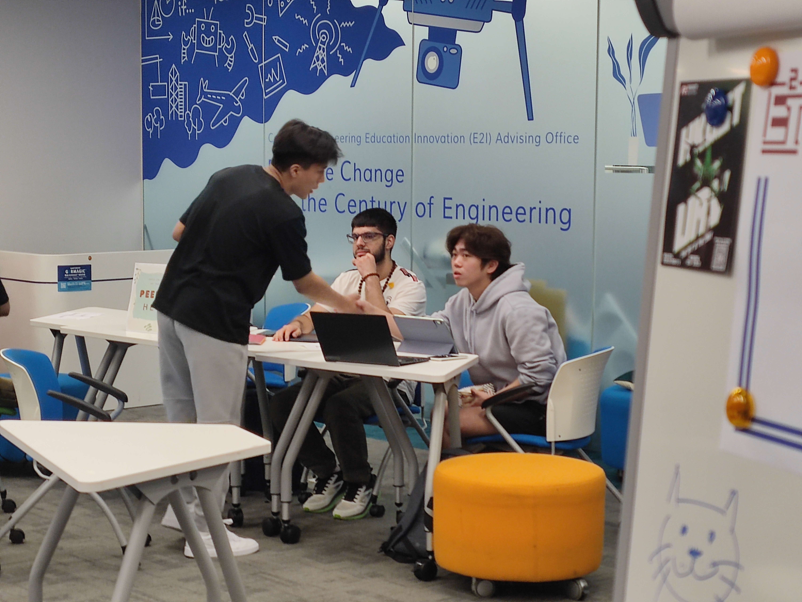
Assignment 1: To Understand - Observe and Interview
1b: Observe in the field
Choose 1-2 people and observe them. Pay attention to how and why people do what they do. Bring your notebook, your plan, and a camera. Take photos/videos to record your observation process
1c: Summarize what you did and saw in Step 1b.
Who did you observe? Where did you observe them? What were the observations that sparked your curiosity? Record them with a photo, story, or quotation. Use photos (which should be taken firsthand by you) to illustrate. Put concise captions to describe the photos.
Figure 1: A computer science undergraduate student in pink shirt studying lecture slides on algorithm’s run time complexity (in library’s LG4 floor)
Figure 2: Three electronic engineering undergraduate students discussing the work distribution for the upcoming project on building certain electronic devices (in the Engineering Common E2I)
You can use Next page
3

Slide 5
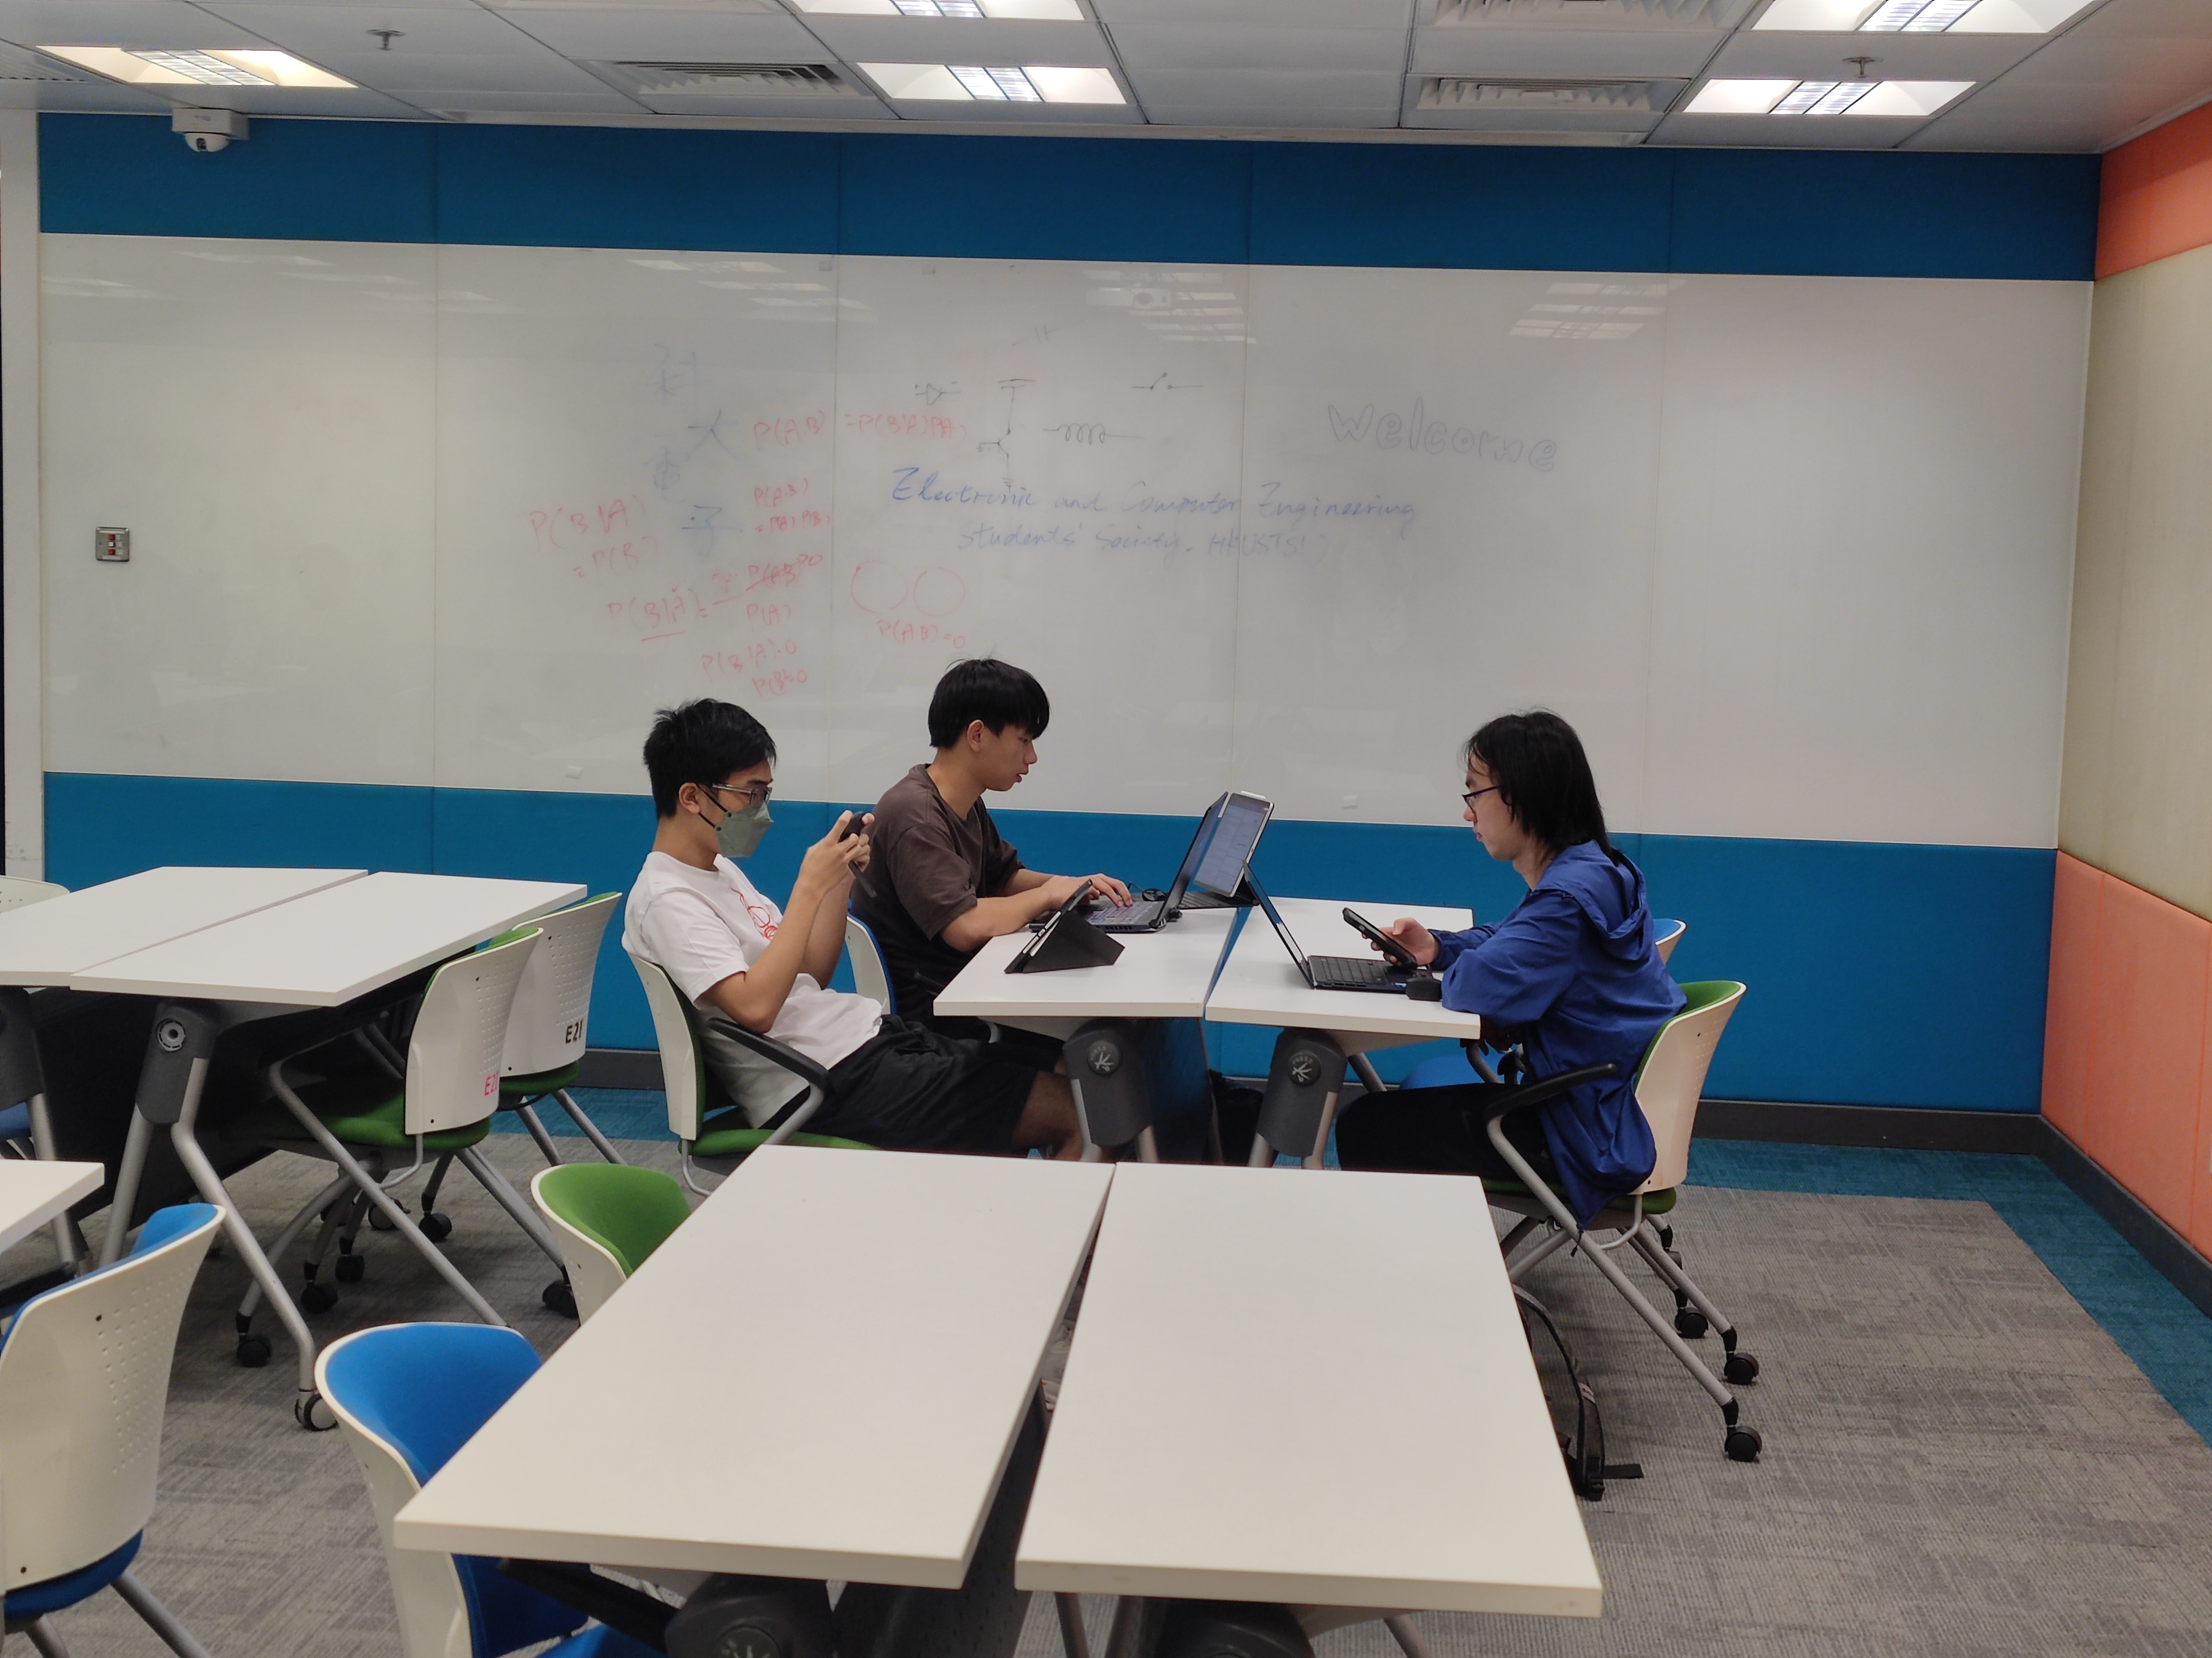
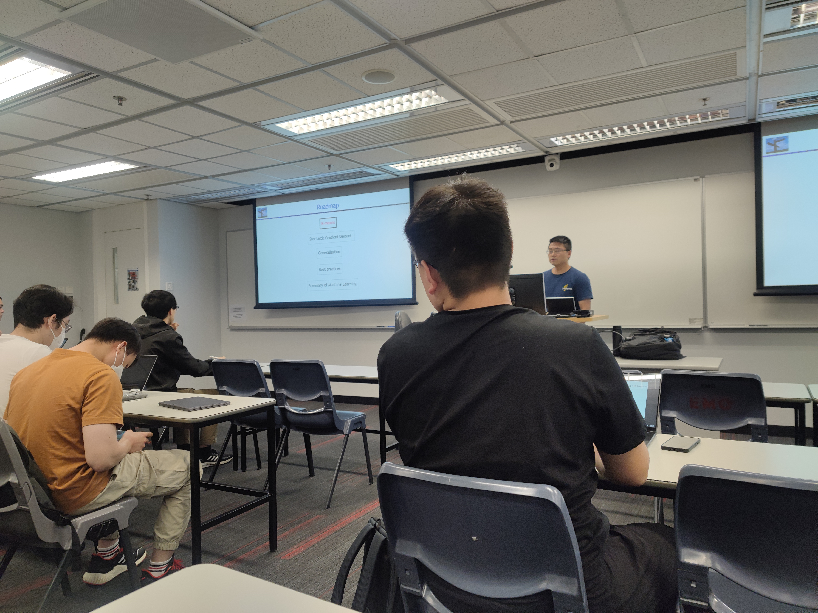
Assignment 1: To Understand - Observe and Interview
Who did you observe? Where did you observe them? What were the observations that sparked your curiosity? Record them with a photo, story, or quotation. Use photos (which should be taken firsthand by you) to illustrate. Put concise captions to describe the photos.
Figure 3: The computer science undergraduate student in blue jacket is doing his programming assignment (in the Engineering Common)
Figure 4: While the professor is discussing the fundamental concept in AI, the computer science undergraduate student in orange shirt is replying messages using his smartphone (in Room 2465) (Course code: COMP3211)
4

Slide 6
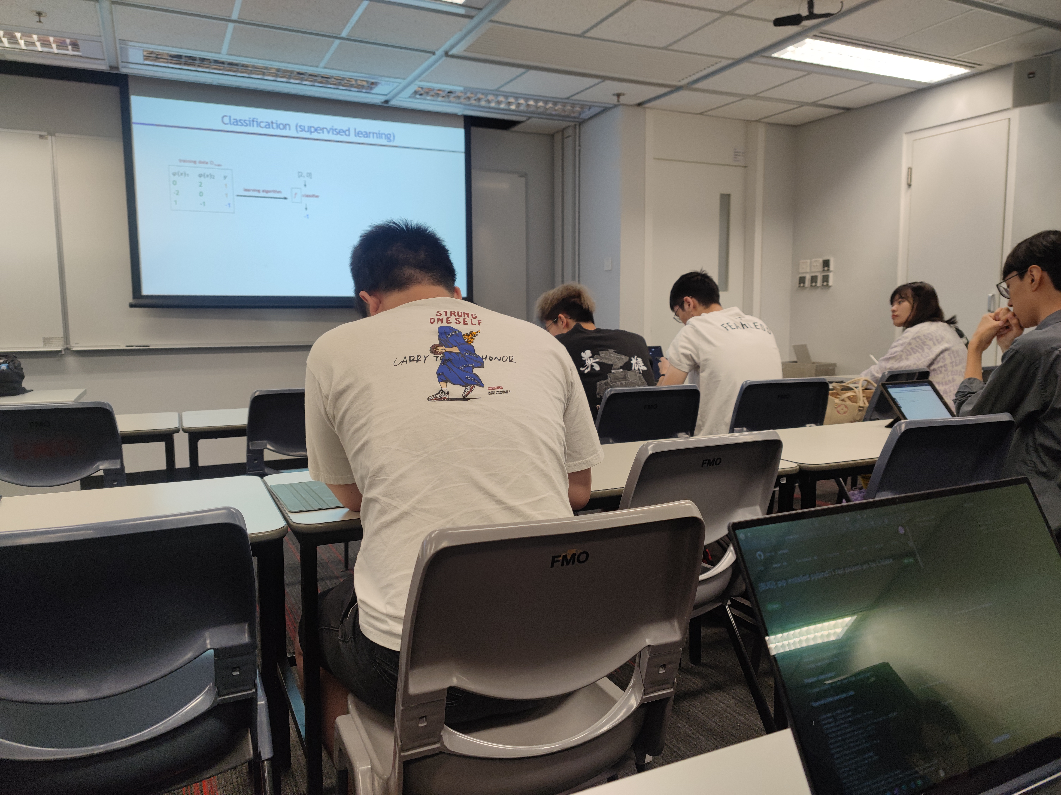
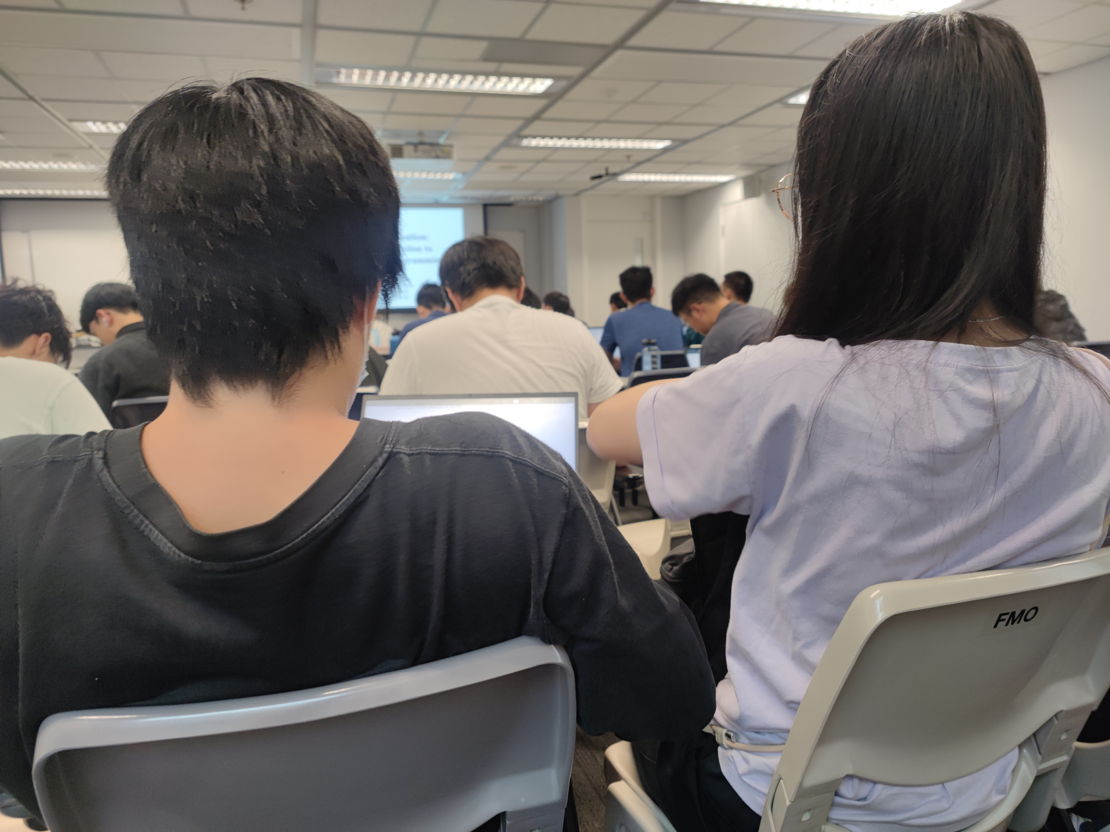
Assignment 1: To Understand - Observe and Interview
Who did you observe? Where did you observe them? What were the observations that sparked your curiosity? Record them with a photo, story, or quotation. Use photos (which should be taken firsthand by you) to illustrate. Put concise captions to describe the photos.
Figure 5: The computer science undergraduate student in black T-shirt with words on the back is chatting with his friend during the class (in Room 2465) (Course code: COMP3211)
Figure 6: The undergraduate engineering student in purple shirt seems to be a bit lost during the lecture, so the student wearing black shirt try to explain to her to solve her problem (in Room 2465) (Course code: IEDA2010)
4

Slide 7
Assignment 1: To Understand - Observe and Interview
Who did you observe? Where did you observe them? What were the observations that sparked your curiosity? Record them with a photo, story, or quotation. Use photos (which should be taken firsthand by you) to illustrate. Put concise captions to describe the photos.
All the pictures above are taken on 13 September, 2023.
I observed HKUST undergraduate engineering students in library, the Engineering Common (E2I) and classrooms that engineering related courses that were conducting. All the above observations were from the morning to the afternoon on 13 September, 2023.
To start with, I would like to start with what I noticed in the library on that day’s morning. I found out that quite a number of engineering students from different engineering department would study the lecture notes there. For around 75% of the cases, the engineering students would just study the lecture materials on their own. For the rest of them, almost all the study group composed of 2 to 4 students for each group, and it was very rare to see the study groups involved 5 students or more. This was one of the very interesting phenomenon that I saw. Why more students prefer to study the engineering lecture materials alone? In addition, I observed when some of the engineering students are struggling with some hard concepts in their lecture notes, they seldom send emails and ask for help from professors or teaching assistants. Why they rarely ask for help from professors and teaching assistants?
Apart from studying the lecture notes, I also figured out some of the engineering students wore their headphones and watched the lecture video recordings in the library. This was another thing that raised my curiosity. Why they intentionally watch the lecture recordings in the library? Why they need to watch the lecture recordings?
(Next page)
4

Slide 8
Assignment 1: To Understand - Observe and Interview
Who did you observe? Where did you observe them? What were the observations that sparked your curiosity? Record them with a photo, story, or quotation. Use photos (which should be taken firsthand by you) to illustrate. Put concise captions to describe the photos.
Secondly, after I have done my observation in the library, I walked to the Engineering Common and I also discovered some interesting findings there. When I arrived the Engineering Common, the time was still in the morning. The most obvious thing I saw was that most of the engineering students here was doing their assignments. Based on what I have heard and saw, I figured out one group of engineering students should be from electronic and computer engineering department, and they are discussing the work distribution of their coming project of one electronic course (but I did not know which ELEC course in specific) on some electronic devices. For those who sat alone, a few of them were from computer science and engineering department as they are doing their programming assignments, while remaining one are from civil engineering, industrial engineering. One interesting observation was that there were some empty seats there. Two question poped out from my mind: Why only a few engineering students do their assignments in the Engineering Common? Why they prefer to do their assignments on their own for those non-project one?
Moreover, sometimes I saw some students face some difficulties in doing their assignments, but they just search for solutions that may be incorrect on the website. Why they did not go to Professor’s office and ask for some answer that are more credible and trustworthy?
(Next page)
4

Slide 9
Assignment 1: To Understand - Observe and Interview
Who did you observe? Where did you observe them? What were the observations that sparked your curiosity? Record them with a photo, story, or quotation. Use photos (which should be taken firsthand by you) to illustrate. Put concise captions to describe the photos.
Thirdly, I went to a classroom to experience the engineering course after my observation in the Engineering Common. The time I was having the lecture was in the afternoon. The first lecture that I was experiencing was a course on introducing the fundamental concept of artificial intelligence (course code: COMP3211). After half of the lecture time was passed, much important information already appeared in front of my eyes. Plenty of students lost their focus on the lectures after the first 10 minutes of lecture, and they started to do something else that were unrelated to the lecture, for example, checking emails, doing assignments from other courses, playing games on their phones, using social media app like Instagram, chatting with their neighbors, replying messages etc.. Also, during the lecture, the professor just narratively speaking every words from the teaching PowerPoint in a very slow pace. To make this environment more boring, his speaking tone was monotone and almost none interaction occurred between the students and the professors. Even though the professor tried to ask the students some question, usually the students would not reply any words. When this lecture came to an end, I found out that most student prefer not to seat on the very front row of seats, and I saw not many students actually came to attend the face-to-face lecture. Only one to two students raised their hands to ask questions to express where they did not understand was also noticed in this observation.
(Next page)
4

Slide 10
Assignment 1: To Understand - Observe and Interview
Who did you observe? Where did you observe them? What were the observations that sparked your curiosity? Record them with a photo, story, or quotation. Use photos (which should be taken firsthand by you) to illustrate. Put concise captions to describe the photos.
Fourthly, I attended another lecture on the introduction of industrial engineering and decision analytics (course code: IEDA2010) to see how was the learning experience offered by different engineering department. Simply just after 10 minutes of the lecture, I have already many problems appeared from the students’ action. I figured out the professor was just speaking the powerpoint in a way too fast manner. Some students seemed like they could not digest and understand what the professor has taught. To make the situation even worse, throughout the whole lecture, the professor did not ask one single questions, or ask whether anyone fully understand what she has just taught. She has little gesture to make her teaching clear.
Based on my observation on two engineering course lectures, several questions showed up from my brain. Why some of the professors teach so fast, while some teach so slow? Why many engineering students would become unfocused during the lecture? Why almost no student are willing to raise their hands to ask questions during lecture? Why the professors are unwilling to provide more interactive activities with the students? And most importantly, who should be responsible for such a poor learning experience, and why?
4

Slide 11
Assignment 1: To Understand - Observe and Interview
1d: Reflection Reflect on your observation.
What are you curious about and want to dig deeper and learn more? Think about user groups, specific contexts, or scenarios. Your observations should inspire areas of interest around the project theme that you will further explore during interviewing. List your assumptions that you draw from the observation.
I have discovered so many interesting phenomenon that are worth me digging deeper. For example, in library, most engineering students watch the lecture video recordings there intentionally; in the Engineering Common, no many engineering students stay there and do individual assignments; in the classroom, the engineering students do not concentrate well while the professors are teaching in an undesirable way. I would like to find out the reasons behind them, and I have a very high curiosity about the relationship between all the observations that I get during that day.
By combining the questions that I have already raised in part 1c, I have a clear direction that I have to dig deeper in the following a few aspects. The first aspect is obviously the teaching quality of the professor. Engineering professor plays a key role in delivering engineering education to the undergraduate students. So, it is crucial to investigate the undesirable teaching quality. The second aspect is the undergraduate engineering students. These students are the one who receive the engineering education, i.e., the user of the engineering education. I need to know about why the students will become losing focusing during the class. The third aspect is the engineering department resources that are provided. I think the engineering departments acts as the suppliers of the engineering education. In case the supply is inadequate, the quality of the engineering education can be adversely affected. The fourth aspect is the engineering education system in HKUST. I would like to know more about how the students view the education system in a big picture. After digging deep in these 4 aspects, I think it may be possible to figure out the relationship between these aspects and understand they are inter-related.
(Next page)
5

Slide 12
Assignment 1: To Understand - Observe and Interview
1d: Reflection Reflect on your observation.
What are you curious about and want to dig deeper and learn more? Think about user groups, specific contexts, or scenarios. Your observations should inspire areas of interest around the project theme that you will further explore during interviewing. List your assumptions that you draw from the observation.
Below are my assumptions that I have drawn from the observation:
(For undergraduate engineering students)
- Always watch video recordings and study lecture notes in library
- Always do assignments in the Engineering Common
- Prefer to study lecture materials on their own
- Prefer the library rather than the Engineering Common
- Most of them easily become unconcentrated during the class
- Always search online solutions to the hard assignment problems
- Never ask professors or teaching assistants every time they encounter difficulties in studying lecture slides
- Rarely raise questions during the class
(For professors)
- All of them either speak too slow or speak too fast during the lecture
- All of them have boring teaching tone
- All of them just narratively speaking every words from the PowerPoint
- Almost never provide any interaction elemsnts or activities to students
- Never have time to reply emails
5

Slide 13
Assignment 1: To Understand - Observe and Interview
Part 2: Interview
Tips: These questions should range from getting to know someone, to theme-specific questions for your project challenge, to digging deeper into specific areas of interest.
Interview your interest groups to understand more.
Prepare 8~10 interview questions before starting the interview. List the questions below.
How do you think about the professor are generally bad at teaching undergraduate engineering students? (Objective: To understand the reasons why the professor’s teaching quality is not ideal)
I notice some students lose their concentration during the lecture, e.g. using Instagram, using Telegram to reply messages, playing smartphone games, chat with neighbor etc. Why do they do that? (Objective: To discover whether the problems that students are not concentrated during the class relates to other stakeholders of engineering education)
Why in most cases, the students would not answer the questions raised by the professors? (Objective: To identify the main causes of the students’ unwillingness to respond the professors.)
Why some of the professors are unwilling to provide a more interactive learning environment? (Objective: To find out the root cause for the non-interactive learning environment)
How do you think about the relationship between professor from engineering school and engineering Undergraduate student? Why? (Objective: To figure out whether the relationship between the professors and students will contribute to an undesirable learning environment)
Do you think your department provides enough resources to ensure you learning experience is good ? Why (Objective: To evaluate the adequacy of learning resources, tools etc in different engineering departments)
Do you think the undergraduate engineering study will help you to get well prepared for a job? Why? (Objective: To see whether the engineering education let student be ready to have a career in the future)
Overall speaking, do you think the engineering education in HKUST is a bit outdated? Why (Objective: To assess whether the engineering education in HKUST can catch up the society’s trend)
Do you think skipping lecture and watching lecture video recording have direct relationship? Why? (Objective: To check whether professor’s teaching quality and watching video recording are interdependent or not)
6

Slide 14
Assignment 1: To Understand - Observe and Interview
2a: Conduct interview
Conduct interview with interest groups to understand more about their concerns and pain points. Interview at least one user or one stakeholder. The more interviewees with diverse background, the deeper you understand their concerns and pain points, the deeper you understand their concerns and pain points, which give you more inspiration for your project. Record the interview process and script.
Tips: You don’t have to strictly follow the prepared questions in interview. Ask follow-up questions (that may not be prepared beforehand) during interview when you get response that interests/inspires you and make you curious. Ask multiple WHY’s to understand the underlying reasons and motivations. Mindset: curious, hamble. You conduct interviews to learn from the interviewees.
2b: Summarize
Who did you interview? What are the highlight moments (list 1~3 moments) from your interview? Why did these stick out to you? Maybe they give you surprise, motivations, unmet needs, or verify/reject your assumptions. You can include quotes from the interviewees, photo/video of the process, or tell a story. Attach the interview scripts.
I have interviewed two undergraduate engineering students from different engineering departments. The first interviewee is called Alex. Alex is a Year 3 student majoring in Computer Science. The second interviewee is called Mo. Mo is a Year 3 student majoring in Civil Engineering.
Highlight moments and the reasons why they stick out to me:
1. When Alex responds that some courses are a bit outdated, it is a shocking news to me. It is because I expect HKUST is a very top university and it should be able to provide the most latest knowledge on technology. But unfortunately, as what Alex mentions, the programming course on C++ does not teach the tools that are widely use in the industry.
7
You can use Next page

Slide 15
Who did you interview? What are the highlight moments (list 1~3 moments) from your interview? Why did these stick out to you? Maybe they give you surprise, motivations, unmet needs, or verify/reject your assumptions. You can include quotes from the interviewees, photo/video of the process, or tell a story. Attach the interview scripts.
Assignment 1: To Understand - Observe and Interview
2. When Alex says that one of the reasons that students lose concentration during the class is due to the boring tone spoken by the professor, I am sad to hear about that. It is because I believe education should be a connecting bridge between the experienced teachers (i.e. professors) and the young people (i.e. the students), but the bridge is broken. The worse situation is that there is almost no interaction between them. To solve this issue, this motivates me to build a prototype product, like some educational tools, that can help to rebuild the linking between students and professors.
3. When Mo replies me that it is very hard to keep full concentration during the class as there are many distraction factors that drive their attention to the professors’ teaching away, this in fact verified my assumptions that “most of the undergraduate engineering students” easily become unconcentrated during the class. When Mo mentions the reason that the students are not willing to raise their hands and ask professors during the lecture is due to the spoon-feeding education in the local secondary school, this is something I am unexpected, but reasonable when I consider that carefully. Even though I think university education is largely different from the secondary school one, but undeniably, just like what Mo has said, “the teacher teach us and then … I think the education system is aims at training the student to become exam-oriented, and put more emphasis on the final results. …In the traditional classroom, we always receive things more often than speak something. ” , I am confident that local students has been greatly affected by the local spoon-feeding education culture, and this is a very direct reason that why most students are not willing to actively ask questions during the lecture. This eventually make all students uniform and lack of their special characteristics, which is not the best type of engineering education I would like to see in the university.
(The interview scripts can be seen starting in the next page)
8

Slide 16
Who did you interview? What are the highlight moments (list 1~3 moments) from your interview? Why did these stick out to you? Maybe they give you surprise, motivations, unmet needs, or verify/reject your assumptions. You can include quotes from the interviewees, photo/video of the process, or tell a story. Attach the interview scripts.
Assignment 1: To Understand - Observe and Interview
Interview scripts (Alex)
Me: I am a Year 3 undergraduate student majoring in computer science. You can call me Vincent. Thak you for joining this interview. So, let’s get started. Before we go to the main questions, would you like to introduce yourself?
Alex: I am a year 3 student majoring in computer science. I admit to HKUST through JUPAS.
Me: Do you have any hobbies?
Alex: I love watching anime.
Me: Would you mind telling me how can I call you?
Alex: You can call me Alex.
Me: Now let’s get started. Here is the first question. How do you think about the professor are generally bad at teaching undergraduate? For example, why they would speak monotonic, why they usually speak too fast?
Alex: Umm, I think it is unavoidable that the professors’ speaking level can be different a lot. If the professors teach poorly, I will concentrate more on the lecture notes and comprehend them myself.
Me: Do you think what are the potential reasons that can explain why they teach the undergraduate engineering student in such a poor way?
Alex: I think the first reason was because of the years of experience in teaching. The second reason is maybe due to the poor expression and presentation.
Me: Do you mean their teaching experience is too little?
Alex: Yes.
Me: Alright. Here is the second question. If you want your professor to teach better, which aspect should they improve first? Why?
Alex: First of all, in my opinion, I think if I want the professor to teach better, they should beware of the rhythm, for example, they should use accents on the key points. Because if they use monotone to teach, students cannot identify which part is the important points. Also, this kind of tone will make the student sleepy and cannot concentrate.
8

Slide 17
Who did you interview? What are the highlight moments (list 1~3 moments) from your interview? Why did these stick out to you? Maybe they give you surprise, motivations, unmet needs, or verify/reject your assumptions. You can include quotes from the interviewees, photo/video of the process, or tell a story. Attach the interview scripts.
Assignment 1: To Understand - Observe and Interview
Me: OK, let’s go to the next question. I find out that many engineering undergraduate student will lose their concentration during the class. For example, they use Instagram, they use Telegram to reply to messages etc. Why do they do these things?
Alex: I think the first reason is related to their learning habit. Maybe they are lazy and would not concentrate for a long time during the lecture. Another possible reason may be due to the boring tone spoken by the professors. They think this is time-consuming and so they do something else to kill time.
Me: OK. I also notice that the students are not willing to raise their hands and answer the questions from the professors. Why this phenomenon happens?
Alex: First, from the view of student, they may be a bit introvert and are unwilling to express their opinions in front of so many people. Another reason depends on the lecture environment. If the professor can be more interactive, this can remove the obstacles those introvert student face and they may be more willing to answer the questions. Such way can make them have fewer burden.
Me: The following question is related to what you have just answered me. Why are some professors unwilling to provide a more interactive learning environment?
Alex: Well, I think teaching is a one-way action that it is not so effective. The professors do not know the needs from the engineering students. The professors do not know what concepts need to be discussed in a detailed manner. Also, if the learning environment is not so active, they are less willing to express themselves.
Me: Oh, so you think the relationship between the students and the professors is not close. What do you think about such kind of relationship? And why that happens?
Alex: I would say rather than saying the relationship is not good, I would say it should because of the less interaction between professors and students instead. Just like I said before, the bad lecture environment. It may not necessarily due to the bad relationship. I would say there are so many hindrances.
8

Slide 18
Who did you interview? What are the highlight moments (list 1~3 moments) from your interview? Why did these stick out to you? Maybe they give you surprise, motivations, unmet needs, or verify/reject your assumptions. You can include quotes from the interviewees, photo/video of the process, or tell a story. Attach the interview scripts.
Assignment 1: To Understand - Observe and Interview
Me: What kind of hindrances? Apart from the one mentioned by you before.
Alex: Let me think a bit. Um, do you mean I need to talk about the details of that hindrances?
Me: You may talk about that.
Alex: I would say the student are not able to let it go. (He wants to express the students do not have enough courage)
Me: So you mean the students are responsible for that?
Alex: Yes. Since there is only one professor and there are many students. Many students, many personalities.
Me: Overall speaking, what do you think about the professors from your engineering
department?
Alex: Umm, based on my opinion and experience, I think if the lecture is related to theory, it would be relatively boring; but if they are related to dealing reality and practicing, such as coding, the environment would be better.
Me: Overall speaking, in your opinion, who should be responsible for the bad
learning/teaching experience?
Alex: I would say this cannot account to who should bear the responsibilities. It depends on many factors. Hmm, if we want the learning environment to improve, professors should have a bigger responsibility. Because professors speak the most words, and they are the leader to push the progress of the course.
Me: Fine. Now, I will switch the discussion topic to something related to teaching assistants. How do you think about the teaching assistants of the engineering courses that you have took? You may talk about the good and bad experiences.
Alex: One of the obvious observations by me is they lack of experiences. You will find that most of them just talking to themselves. The interaction moment is very little. The students may not be able to answer the questions raised by teaching assistants immediately.
8

Slide 19
Who did you interview? What are the highlight moments (list 1~3 moments) from your interview? Why did these stick out to you? Maybe they give you surprise, motivations, unmet needs, or verify/reject your assumptions. You can include quotes from the interviewees, photo/video of the process, or tell a story. Attach the interview scripts.
Assignment 1: To Understand - Observe and Interview
Me: But they are the future professors. How do you think they can improve?
Alex: I have already said that it is due to lack of experiences, and it is hard to avoid. The only effective way is to give them more chances to practice. If necessary, they should collect the comments from undergraduate students and the experienced professors.
Me: Do you think your department provides enough resources to ensure you learning experience is good?
Alex: I would say it is enough. For example, there is a platform call ZINC, which is used to collect coding assignments. Practice is important, so ZINC is a very good resource. I do not feel any obvious inadequacy in resources.
Me: Do you think the undergraduate engineering study will help you to get well
prepared for a job? Why?
Alex: I would say if students purely learned computer science knowledge, it is very hard for them to find a job, or I should say it is impossible. Since students takes some general courses in Year 1 to 2, like Mathematics and English. After choosing the major, students need to use 1 year of time to take department fundamental courses. When students proceed to Year 3, they can really start to enroll in some courses that are special within their department only. Students may finish the fundamental requirement in the Fall or Spring of Year 3 before they can finally choose the major electives. In my case, I finish all the fundamental requirement in Year 3 Fall semester, and I have only 3 semesters to choose the elective courses. The choosing time is very short, or even inadequate.
Me: Do you think the reason behind such phenomenon may be due to the over-emphasis on theory, and too little emphasis on practice?
Alex: It could be. But I understand that. Many theories are crucial. In fact, I hope I want more real-life practices.
Me: Overall speaking, do you think part of the engineering education in HKUST is a bit outdated?
8

Slide 20
Who did you interview? What are the highlight moments (list 1~3 moments) from your interview? Why did these stick out to you? Maybe they give you surprise, motivations, unmet needs, or verify/reject your assumptions. You can include quotes from the interviewees, photo/video of the process, or tell a story. Attach the interview scripts.
Assignment 1: To Understand - Observe and Interview
Alex: Umm…
Me: You may talk about the system or something you would like to say.
Alex: I would say some of them are a bit outdated.
Me: Can you give me some more details?
Alex: Take me as an example. I am a computer science student. C++ is a main programming language I always use. There is a very important concept called STL (Standard Template Library, a useful tool in developing software) in C++. The coverage of STL is too little in the class. Even the final exam does not cover that. But I think STL is very broad in C++ programming in the industry. Plus, smart pointers are not discussed in the class. I think it would be better if there are courses focus on discussing these concepts.
Me: So you have just stated that some of the courses’ design is not ideal. If you have the choice, how would you redesign those courses?
Alex: I do not think those courses have something redundant. Instead, I would say there are some inadequacies. I think it would be better if the professors have more time to teach more.
Me: If you can take the courses that have been redesigned by you one more time, what do you think about it?
Alex: It would be really nice. And just like what I mentioned earlier, the courses teach not enough, but not necessarily the teaching is bad.
Me: I will move on to some minor questions. I notice that many engineering students prefer to study lecture notes on their own in the library, but less likely to be in groups. How do you think about that?
Alex: I would say the students take different courses. Different courses have different sections. Actually, it is hard to concentrate some students to enroll the same lecture section. Basically, it is hard to know someone else during the class. Although the students in the same major can know each other during the class, it is a different story for Year 1 student. The Year 1 students usually have different goals, they can hardly have new friends until they are in Year 2 and form communication groups.
8

Slide 21
Who did you interview? What are the highlight moments (list 1~3 moments) from your interview? Why did these stick out to you? Maybe they give you surprise, motivations, unmet needs, or verify/reject your assumptions. You can include quotes from the interviewees, photo/video of the process, or tell a story. Attach the interview scripts.
Assignment 1: To Understand - Observe and Interview
Me: I also notice that many engineering students intentionally watch lecture video recordings in library. Why do they do that? And why they usually choose to do such thing in the library?
Alex: Library is a quiet place that you will automatically be quiet when you enter. You will not disturb other people. Also, it provides a silent environment for you to study and watch those videos.
Me: Do you think skipping lecture and watching lecture video recording have direct relationship?
Alex: Can you repeat the question? I cannot hear that well.
Me: Do you think skipping lecture and watching lecture video recording have direct relationship?
Alex: It is a very direct relationship. But I think if students are allowed to watch the lecture video recordings, it is just another choice so that this gives flexibility to students. The students can manage their time well and do not need to attend lectures in specific time slots.
Me: I see not many engineering students use the Engineering Common (E2I),
compared to many engineering students go to the library. What do you think about that?
Alex: I would say there are too many choices for students. In fact, library, computer barns, these places provide places for students to learn and study. I would say only a few students use the Engineering Common is not a negative phenomenon.
Me: OK, let’s continue. Do you have any idea why the engineering student usually talk about project and do assignment in the Engineering Common, but not Library, or elsewhere ? What do you think?
Alex: It is because the Engineering Common allows them to communicate with each other using spoken language. Just like what I have said before, library is a quiet place and people normally would not talk loudly. I think the Engineering Common is a place that is more noisy and welcome people to chat.
8

Slide 22
Who did you interview? What are the highlight moments (list 1~3 moments) from your interview? Why did these stick out to you? Maybe they give you surprise, motivations, unmet needs, or verify/reject your assumptions. You can include quotes from the interviewees, photo/video of the process, or tell a story. Attach the interview scripts.
Assignment 1: To Understand - Observe and Interview
Me: I am going to ask the very last question. How do you think about the engineering education system? Why do you think so? You may take our university as an example.
Alex: I am still satisfied with that. I can learn so many things and I would not feel like it is wasting my time.
Me: Our school utilize academic credit system. Would you think it is a bad idea for using credit system as our engineering education system? Do you have any better suggestions on our education system?
Alex: I do not think there is a big deal in academic credit system as our engineering education system. It would not affect our learning that much.
Me: Thank you for spending the time to attend this interview.
Alex: You are welcome.
(The end of the interview with Alex)
8

Slide 23
Who did you interview? What are the highlight moments (list 1~3 moments) from your interview? Why did these stick out to you? Maybe they give you surprise, motivations, unmet needs, or verify/reject your assumptions. You can include quotes from the interviewees, photo/video of the process, or tell a story. Attach the interview scripts.
Assignment 1: To Understand - Observe and Interview
Interview scripts (Mo)
Me: I am Vincent, and I am currently a Year 3 undergraduate student majoring in computer science. Thak you for joining this interview. So let’s begin! Before we go to the theme of this interview, can you please introduce yourself first? You can talk about your name, your major, your interests and personalities.
Mo: I am Mo. I am a Year 3 student. I am studying Civil Engineering. I often do some exercises. For instance, I usually play basketball, play table tennis, running and go to gym. My interests are mainly doing sports, and I sometimes go to the school library to study.
Me: OK, let go to main theme then. First, how do you think about the professor are generally bad at teaching undergraduate? Some of the examples that reflect bad teaching are the boring teaching tone and speaking too fast.
Mo: I would say it is not that bad. I would say that is just an “Okay” level. But, I still agree with what you have said. Indeed, the tone is too monotonous, speaking too fast. Sometimes, we may not be able to digest the teaching materials well. It is because university different quite a lot in terms of having class when compared to secondary school. Unlike in the secondary school that the teachers would cater the needs of the students and talk about something else that are not covered in the syllabus but still worth to learn, in the university, it is completely straight ahead. For 1 hour and 20 minutes, the professors just simply talk about the lecture notes. Talking about the teaching quality, I think it depends on different professors. Until now, I think most of the civil engineering professors are quite interesting. Maybe some of them are relatively more monotone and boring, but in general they are interesting, or maybe I love the things related to civil engineering. So far, I am still quite enjoying that. Since I have not took many courses, like common core courses at this moment, but I still think the teaching is Okay, not too bad. However, if talking about problems, it still exists, like speaking too fast. Or, maybe some professors come from another countries and they may not know about the secondary school education system in Hong Kong. For instances, they may not know such knowledge are not taught in Hong Kong secondary school, but they are taught in IB (International Baccalaureate).
Me: Oh, so you think there are quite many different reasons that contribute to their poor teaching, but not just solely due to a few specific reasons?
8

Slide 24
Who did you interview? What are the highlight moments (list 1~3 moments) from your interview? Why did these stick out to you? Maybe they give you surprise, motivations, unmet needs, or verify/reject your assumptions. You can include quotes from the interviewees, photo/video of the process, or tell a story. Attach the interview scripts.
Assignment 1: To Understand - Observe and Interview
Mo: Yes. In my opinion, if you have any problems, you can directly say that to the professors, and he/she may tune that. It is because I took some Mathematic courses before. I told the Mathematic professor that I could not get used to that. He/She therefore slow down the teaching pace a bit. I think as long as you are willing to speak to the professors, they may cater to students’ needs.
Me: OK. Now, here is the second question. If you want your professor to teach better, which aspect should they improve first? And why?
Mo: Of course I know the lecture time is precious, but I still want the professors can talk a bit more something else that are not covered in the lecture notes. I do not want them to only just say the words in the lecture notes. I know the time is precious and limited, especially in the winter and summer semester. I would prefer they can talk about something interesting topics than just only focusing on the lecture notes. For example, I think they can use 5 minutes to talk about something extra to catch our focus, and do not just only concentrate on the things appeared in the lecture PowerPoint slides. Maybe this can motivate us a bit.
Me: Fine. During the lecture, I notice some students lose their concentration, for example, using Instagram, using WhatsApp to reply messages, playing smartphone games, chat with neighbors etc. Why do they do that?
Mo: Just like what you have said, they lack concentration. In my opinion, it is very challenging to stay completely focused for the entire 1 hour and 20 minutes of lecture, and even some of the lectures last for 3 hours. For example, the courses I took in the last summer semester. I figured out that it is very hard for me to stay focused, even though those lectures may have some break sessions in between. In addition, some of the students would build “pillars” in their timetable.
Me: Do you the students want to build a timetable such that they can have lectures from the morning to the evening without any breaking session for themselves?
Mo: Yes. They may want to attend around 3 lectures in a non-stop manner. It is very hard to keep 100% concentration. And also, talking about chatting with the neighbors during the lecture, I think maybe sometimes when the students are not quite getting what the professors have taught, they may ask their neighbors to explain more on that. I do not think it is losing concentration during class. All in all, the main reason is lack of concentration. Moreover, the distractions are very huge during the class. In some situations, maybe Instagram, or even the popularization of the Internet and smartphone, this makes the student click something else on their phone. But still, the main reason is lack of concentration.
8

Slide 25
Who did you interview? What are the highlight moments (list 1~3 moments) from your interview? Why did these stick out to you? Maybe they give you surprise, motivations, unmet needs, or verify/reject your assumptions. You can include quotes from the interviewees, photo/video of the process, or tell a story. Attach the interview scripts.
Assignment 1: To Understand - Observe and Interview
Me: Fine. I continue to ask something about what I observed in the lecture. Why in almost all the time, the students are not willing to raise their hands and ask professors during the lecture?
Mo: I think this is greatly related to our traditional education system (in Hong Kong). In my opinion, for those traditional secondary schools and I am not saying those schools that their default university entrance exam is IB, I think those traditional schools utilize the spoon-feeding education. Mainly speaking, the teacher teach us and then we (the students) go home and do the past exam paper, do the homework and then submit it. Ou education system has always been such a way. I think the education system aims at training the student to become exam-oriented, and put more emphasis on the final results. In most of the times, the marks you get represents quite many things. However, the learning process is ignored and omitted. I think education should be active learning, but not passive learning. Therefore, it is related to passive learning. Furthermore, by investigating the HKDSE exam system, speaking is not important. In the traditional classroom, we always receive things more often than speak something. But for some courses in IB exam system, they allow students to speak more, do more project assignments, group project, and more discussions from different courses and subjects. And in traditional classrooms, you can sit for a whole day there without saying a single word. The teachers would not force you to speak unless they ask you several questions. But for Hong Kong’s education system, in general, speaking portion is relatively little in traditional secondary school. Plus, this also relates to the people.
Me: The following question that I am going to ask is more or less related to what you have just told me. Why are the professors unwilling to provide a more interactive learning environment?
8

Slide 26
Who did you interview? What are the highlight moments (list 1~3 moments) from your interview? Why did these stick out to you? Maybe they give you surprise, motivations, unmet needs, or verify/reject your assumptions. You can include quotes from the interviewees, photo/video of the process, or tell a story. Attach the interview scripts.
Assignment 1: To Understand - Observe and Interview
Mo: This is just like what I have said. Some local professors know Hong Kong’s education system has always been spoon-feeding. The professors can hardly know each students’ characteristics. Students generally just sit down and listen to what the teachers have taught, rather than communication with each other. Also, time is very precious. Even though the students are attending the language courses in the university, the time for discussion is usually 5 minutes or shorter. You would not say the time for discussion is a lot. By the way, many things are required to be taught in the class, and there is not much time for free discussions. The time is too rash. The schedule is too tight, and the professors cannot allow more discussions. Even though some professors want to have more time for discussion, but due to the lecture progress, and even though I see that some professors allow students to discuss, do you many students would likely to talk or discuss? (He implies not many students are actually willing to discuss or talk) Also, I think it is limited by the design of the classrooms and lecture theatres. It is hard to allow the students to discuss or talk with their neighbors on the front, the back, the left and the right side. Usually, it is due to geographical limits.
Me: OK. I will now ask some questions related to the engineering students and the professors. How do you think about the relationship between professors from engineering school and engineering Undergraduate students?
Mo: I personally think this kind of relationship depends on different people. Some students can be very close with the professor, like having the meals with the professors, while some are totally not, like they will meet the professor for the first time during the final exam. Anyway, this depends a lot on different people. But in general speaking, I would say students are not close with their professor, not extremely close at least for myself, but I do not judge the same thing for the other student. Since the professors are usually very busy, so for me, I am not close. Hence, the professors may not be able to recognize most of the students. Despite this, I still ask my professors for something. Take me as an example, I will ask Professor Anthony Leung for something related to civil engineering.
Me: Can you tell me more about this professor (Professor Anthony Leung)?
Mo: He is the undergraduate program coordinator. When I have some problems with my Civil Engineering major and the artificial intelligence (AI) extended major, I will address his opinions. Plus, I have an advisor. My advisor is focused on the Civil Engineering plus AI extended major. I always ask for his advice. I will ask these professors to discuss my further studies. I will also ask other professors when the lectures come to an end. But if you ask me whether I am super active and will ask them all the time, as I am coming from Hong Kong local school, I am not quite active in asking questions.
8

Slide 27
Who did you interview? What are the highlight moments (list 1~3 moments) from your interview? Why did these stick out to you? Maybe they give you surprise, motivations, unmet needs, or verify/reject your assumptions. You can include quotes from the interviewees, photo/video of the process, or tell a story. Attach the interview scripts.
Assignment 1: To Understand - Observe and Interview
Me: Good. Overall speaking, what do you think about the professors from your engineering department?
Mo: I think most of the professors from civil engineering teach in an interesting manner. Since I have some bias that I love civil engineering, this make me think the content of civil engineering is very interesting. In addition, I think the professors are quite good. Temporarily speaking, I think the professors in my department can bring me much joy. Maybe they can use different methods like iPRS to strengthen the interaction.
Me: OK. Overall speaking, who should be responsible for the bad learning and teaching experience? Why?
Mo: I am afraid that I cannot regard that as a responsibility. Everyone has their own responsibilities. Students have their own responsibilities to maintain their good learning experience. But if you tell me that I need to choose one, I think the university should be responsible for that. The university should organize more activities to encourage the professors to interact more with the students. I see there are a few now as well. For example, professors would give out the gifts for students in the Engineering Common. Even though there are a few of these kinds of activities are held, I think they can organize more and do more such activities.
Me: What do you mean “do more things”?
Mo: Hmm, take my department as an example. I know my department will hold the basketball competition and table tennis competitions to allow more exchange between professors and students. But despite this, since some of these competitions are held during the middle of the semester, near the midterm exam and near the final exam, so it is hard for me to manage to find some free time to join them as I need to do revision for my midterm and final exams. Therefore, I would like them to hold more such activities at the very beginning of the semester.
Me: Great. I am now going to switch to other discussion topic. I would like to ask something related to teaching assistants first. How do you think about the teaching assistants of the engineering courses that you have taken? Would you share some good experiences and bad experiences?
Mo: In general, I think the teaching assistants are OK. A normal teaching assistant has a certain level of academic knowledge. The teaching assistants that I usually encounter are PhD Year 1 students. But maybe I seldom encounter teaching assistants, my answer may not be giving the big picture. For the good teaching assistants, their explanations are very clear. For the bad teaching assistants, for example, they may just simply speak the words in the PowerPoint slides and teach in a monotonous tone.
8

Slide 28
Who did you interview? What are the highlight moments (list 1~3 moments) from your interview? Why did these stick out to you? Maybe they give you surprise, motivations, unmet needs, or verify/reject your assumptions. You can include quotes from the interviewees, photo/video of the process, or tell a story. Attach the interview scripts.
Assignment 1: To Understand - Observe and Interview
Me: Do you think your department provides enough resources to ensure your learning experience is good?
Mo: Resources…, I have not fully discovered all the resources, so I am not so sure. But I know the resources exist, like they will encourage us to join the membership outside our school. But on the other hand, since I am CIVL+AI (Major in Civil Engineering with an extended major in artificial intelligence), I think the department support for this pathway is not big since I face some struggles in this path. It is because the department does not provide related courses to guarantee some courses can fulfill the CIVL major and AI extended major requirements at the same time. So in my opinion, the support for such thing is not enough. Moreover, university differs a lot when compared to secondary school. You have to find the resources yourself actively. Really a big difference. Unlike the teachers will tell you what resources are available in the secondary school.
Me: Apart from the inadequate resources to support the CIVL+AI pathway, do you think of any other aspect that are lack of resources.
Mo: The resources are enough. We have internships and department denomination. Because you can ask the professors about the internship chances, and the elder brothers and sisters will provide different resources. Our department has dedicated student ambassadors. They will help and take care of us. They will invite us to have meals, have chats and provide extra support. I do not know whether similar things apply to other department or not since I do not really know about other department.
Me: OK. Let’s move on to the next question. Do you think undergraduate engineering study will help you to get well prepared for a job? Why?
8

Slide 29
Who did you interview? What are the highlight moments (list 1~3 moments) from your interview? Why did these stick out to you? Maybe they give you surprise, motivations, unmet needs, or verify/reject your assumptions. You can include quotes from the interviewees, photo/video of the process, or tell a story. Attach the interview scripts.
Assignment 1: To Understand - Observe and Interview
Mo: I think it depends on people. If the professors or the school give you chances and you do not strive for these chances properly, it would be useless. Similarly, if the school offers you the courses and you do not study them, you cannot blame the school for not giving you any resources. This is personal problem. However, if the personal problem is omitted, I think the resources are still adequate. It is because the pathway of our department is fixed that we need to study enough courses. Since the major design strictly follow what HKIE (The Hong Kong Institution of Engineers) has required for the qualification and the scheme A. So I think the courses in civil engineering have already helped us to build the road to become civil engineers. It is very good if the students follow the pathway they prepared for you. Maybe this is a bit different from the computer science and engineering department. I have some friends studying computer science, and they need to plan their pathway, consider which computer science elective courses to take first etc. Due to this factor, and I also think civil engineering is a traditional industry, so the pathway is fixed. I need to study something related to geotechnical and structural before I graduate, so that I can fulfill the requirements from HKIE. I think this aspect is good. On the other hand, since our civil engineering official website has listed the whole suggested pathway, so we can simply stick to that. Also, internships are enough. Because some big companies’ internships are provided by the school.
Me: OK. Overall speaking, do you think the engineering education in HKUST is a bit outdated? Since you have mentioned civil engineering is a relatively traditional faculty.
8

Slide 30
Who did you interview? What are the highlight moments (list 1~3 moments) from your interview? Why did these stick out to you? Maybe they give you surprise, motivations, unmet needs, or verify/reject your assumptions. You can include quotes from the interviewees, photo/video of the process, or tell a story. Attach the interview scripts.
Assignment 1: To Understand - Observe and Interview
Mo: I think it is not necessary to classify it as traditional or not. I think every major are following the society’s trend. Although civil engineering is a traditional subject, the problems encountered are not traditional. For example, black rainstorm signal was hoisted in the last week (7 September 2023) and flooding and land sliding occurs everywhere in Hong Kong. It is said that the rainstorm is occurred once in every 500 years. You cannot say it is traditional or outdated. The professors also explain a lot to us about that rainstorm. Also, for those who have not studied geotechnical engineering, this subject actually contains many variables, and they are not hardly fixed. Different concrete has different properties and they are produced in the factories. So, talking about engineering education …, I have not received education from other university other than HKUST and I do not how is the education in other universities. Plus, I rarely ask about the students in other universities. But, I still think the professors here would regularly update. For instance, in the past, I studied a BIEN (bioengineering) course. The professor will also talk about COVID-19 and the corresponding vaccine. The materials from the course are bridged to what the world is happening now. In addition, in civil engineering, it is recommended to use AI. For example, I see some UROP (undergraduate research opportunity program) courses use AI to see construction safety in construction site. So, I think the professor here is quite updated to follow the world’s trend. They still continue to learn something. Thus, I think the professors can bring us about what is happening in the world and Hong Kong.
Me: I see. Do you think the design of the engineering course you have taken should be redesigned?
Mo: I do not study quite many engineering courses currently. I mainly study BIEN and …
Me: You may also talk about the CIVL courses.
Mo: Generally speaking, I think the CIVL courses are quite good since they have a very long history. I heard from my professors that the courses that we are taking now are also being taught back in year 2004, such as CIVL3730, CIVL3740. They are continuously being improved and I think it is quite good.
8

Slide 31
Who did you interview? What are the highlight moments (list 1~3 moments) from your interview? Why did these stick out to you? Maybe they give you surprise, motivations, unmet needs, or verify/reject your assumptions. You can include quotes from the interviewees, photo/video of the process, or tell a story. Attach the interview scripts.
Assignment 1: To Understand - Observe and Interview
Me: If you can redesign the engineering courses that you have taken, how will you design it? Would you mind giving me an example? You may also talk about the courses you take this semester.
Mo: Umm, since I do not take many courses in this semester…, but if talking about the courses that I have taken in the past, I would like to talk about a course with course code named CIVL2410. This course is about environmental assessment. This course is mainly for the students who are studying civil and environmental engineering (CIEV). It is because in Year 3, our department has divided the students into CIVL and CIEV streams. If you are not a CIEV student, probably this course is the only course that talk about environmental engineering in your whole undergraduate study. So, many CIVL students may not be able to know more about the things related to environmental engineering. I think this course can be improved by allowing more site visiting so that students can see whether they want to develop themselves in environmental engineering. Hence, they can know more about which one among CIVL and CIEV better suits themselves.
Me: Good. Now I will switch the discussion topic a bit. I would like to discuss something that I have observed in the library and the Engineering Common. To start with, I would like to talk about the observation I have made in the library. I notice that many engineering students prefer to study lecture notes on their own in the library, but are less likely to be in groups. How do you think about that?
Mo: First, I think the way of studying varies a lot among different people. Since I always study alone, I think studying alone would bring me a higher efficiency. In addition, I do not like studying with other people. Also, the library should not be allowed to talk in my opinion, and I have no idea why some students love to chat in the library. Thus, I am not quite like that, except the learning common in level LG1. Plus, there is joy when a group of people study together and this allows helping each other. But I do prefer studying alone because I like a silent studying environment. I concern much about the learning efficiency. I think studying together would eventually become chatting with each other eventually. But of course, for those people who are in a club or society, studying in a group can be helpful as someone in the group can help someone else in the same group. I rarely study in a group, so I think it is hard to say the benefits of studying in a group. However, even though I join a study group, I still study alone and I would not chat with other.
8

Slide 32
Who did you interview? What are the highlight moments (list 1~3 moments) from your interview? Why did these stick out to you? Maybe they give you surprise, motivations, unmet needs, or verify/reject your assumptions. You can include quotes from the interviewees, photo/video of the process, or tell a story. Attach the interview scripts.
Assignment 1: To Understand - Observe and Interview
Me: I also notice that many engineering students intentionally watch lecture video recordings in the library. Why do they do that? And why they usually choose to do such thing in the library?
Mo: The first thing is because the library is quite. Plus, since it is currently summer season and it is hot. The library provides a quiet environment, air conditioning and free Wi-Fi Internet access, which is very comfortable. Speaking of why they intentionally choose the library to watch the lecture video recordings, I am not quite sure about the reason behind. But I would say the library is quiet that allows student to focus, and other people in the library is very hard-working. You would not relax and so you would quickly watch the lecture notes and then do something else and do the revision. Oh, do you want to ask why the students watch the recordings …
Me: Yes, I know what you mean. I want to ask do you think skipping lectures and watching lecture video recording have direct relationship?
Mo: I personally do not have any preferences on whether attending face-to-face lecture or watching lecture video recordings is better, since there are benefits in both side. Watching lecture video recordings allows students to make their time management better. The student can know when to attend the lecture, when to relax or do other things. After all, studying at university is busy, and it is unlike secondary school that prohibits you to absentees without providing proper reasons, unless the courses require attendance rate. I think this allows students to adapt to their time schedule, which is good for students. Furthermore, lecture video recordings can be viewed anytime and anywhere. Maybe the university students always have something else to work with, they need to do part time job and internships, so I think is it a good idea that the student can adapt to their own schedule and pace. Moreover, one of the benefits of watching lecture video recordings is that student can set the playback speed as “2 times” speed. Maybe the student’s learning pace is so quick and therefore he can set “2 times” speed to watch the whole lecture video recordings. They can use 1 hour of time to learn 2 hours of knowledge, which is a good thing. For those who are not quite good at learning, they may set the playback speed as 0.5 times speed or normal speed. They can check the video recording for one more time to see which places they are clear and which places they are not quite familiar with. They can use this way to do revision. To conclude, although some students actually skip the lecture and then watch the recording afterwards, some of them may be just good at time management.
8

Slide 33
Who did you interview? What are the highlight moments (list 1~3 moments) from your interview? Why did these stick out to you? Maybe they give you surprise, motivations, unmet needs, or verify/reject your assumptions. You can include quotes from the interviewees, photo/video of the process, or tell a story. Attach the interview scripts.
Assignment 1: To Understand - Observe and Interview
Me: OK. I would now like to ask something related to what I observed in the Engineering Common. I see not many engineering students use the Engineering Common (E2I), compared to many engineering students who go to the library. What do you think about that?
Mo: I think they have the freedom to choose. I do not like to sit in the Engineering Common since it is a bit too noisy. It is more suitable to discuss group projects and more convenient to chat. Also, the Engineering Common closes relatively early. I remember the Engineering Common would close at around 5pm to 6pm, which may not allow you to sit there to very night. I usually go to the library since I stay there until around 7pm to 8pm. Maybe the library can give me such a long available operation time. All in all, you need to move your things to somewhere else when the Engineering Common closes, the people staying there is noisy as they are discussing their group project.
Me: Apart from what you have mentioned, do you have any idea why engineering students usually talk about project and do assignment in the Engineering Common, but not the library ,or elsewhere?
Mo: The Engineering Common allows people to chat. Also, the seats there is suitable to discuss projects. In the library, the seats are designed for single person to use, which makes the discussion of projects is nearly impossible. In addition, in the Engineering Common, the chairs can be circled around the tables to allow discussing group projects, and maybe the good location as well. Moreover, I would like to pointe out that the seats in the library is not user-friendly while the seats in the Engineering Common is more user-friendly.
Me: Do you mean the seats in the Engineering Common are more user-friendly?
Mo: Hmm…, you may say in such a way. Also, except for those who do not live in the hall, the location of the library is not that convenient. I would say the location of the Engineering Common is a place most students must pass through (unless you are talking about “sky walking” when there are many people in the corridor). Also, since the Engineering Common is much smaller than the library, if you invite somebody to wait at the Engineering Common, students can find the people they want to find by walking for a short while in there. The library is too big, it is hard to search for one people.
Me: The following is the last question I would like to ask. How do you think about the engineering education system?
8

Slide 34
Who did you interview? What are the highlight moments (list 1~3 moments) from your interview? Why did these stick out to you? Maybe they give you surprise, motivations, unmet needs, or verify/reject your assumptions. You can include quotes from the interviewees, photo/video of the process, or tell a story. Attach the interview scripts.
Assignment 1: To Understand - Observe and Interview
Mo: Since I only study civil engineering, I am not sure about other departments’ situation. Since I have taken some civil engineering courses and also some AI courses, I think the education is quite good. The professors are great. Plus, civil engineering’s pathway is fixed, for example, you need to study CIVL2510 to satisfy the pre-requisite before enrolling CIVL3510. The pre-registration of the course is just like this as our department has already helped us to get the pre-registration of the courses prepared. So, in overall feeling, the education is good.
Me: But would you think that this can be a not-so-good place?
Mo: I understand what you mean. Because there are many choices in computer science and relatively free to choose the thing you like, for example, undergraduate computer science student can choose to enroll post-graduate courses. I know that. But my personality is that I love following the certain pathway and I think this is quite good, so I think it depend on different people. I know some of my friends have decided to study which courses and then follow by which courses. Anyway, the freedom in studying computer science is very big. I like following pathway and so I think it is better for me.
Me: OK. And I want to ask do you think that our school utilize academic credit system is a good idea or not.
Mo: Do you mean something like best 6 …
Me: No, I mean that if you finish a certain amount of credits, you can graduate.
Mo: This is very good. Since I have heard that the students from the University of Hong Kong (HKU) need to pay extra money if they want to study more courses. But for HKUST, there is no such a limit. If you have the ability, you can take as many as you want, which is quite good. After all, if you divide the graduation requirement of 120 credits by 8 semesters of the undergraduate studies, every semester a student should take about 15 credits, of course you can take 18 credits per semester or even apply for credit overloading. Generally speaking, the level of freedom in HKUST is greater than that in HKU. But in HKU, based on my understanding, the students there usually do double major, while the students from HKUST only have one single major.
8

Slide 35
Who did you interview? What are the highlight moments (list 1~3 moments) from your interview? Why did these stick out to you? Maybe they give you surprise, motivations, unmet needs, or verify/reject your assumptions. You can include quotes from the interviewees, photo/video of the process, or tell a story. Attach the interview scripts.
Assignment 1: To Understand - Observe and Interview
Me: Apart from the academic credit system, what else do you think such that this may improve the engineering education in HKUST? For example, if we do not use the academic credit system.
Mo: I would say just strictly follow the requirements from the department. If you are from civil engineering, you study all the courses provided by the department. But still, I think academic credit system is at least the best approach so far. But… I think it is very easy to study over 120 credits in 4 years of undergraduate studies.
Me: Have you ever considered it may be a better idea if the courses do not give you grades?
Mo: Do you mean not releasing the letter grades?
Me: Yes.
Mo: I think it is not acceptable. It is because after all, we still need to differentiate who are relatively good students and who are the relatively bad students in terms of academic. I think university is just a turning point before fully stepping into the society, or I would say studying university is just a process before entering the society to work. Although undesirable academic result does not mean you are not having good working ability, the grades are the criteria for the basic understanding, and the consideration standard for applying for studying MPhil or PhD. It is because based on my understanding, the minimum requirement for applying master studies for civil engineering requires you to graduate with second honor. This can filter out some applicants. At least there is a standard here for the students or the graduate school to reference. I think it is a must to give letter grades. Giving grades can motivate the students to study. Your question is in fact the same as the HKDSE…
Me: You mean exam-oriented is not good?
Mo: No, I think exam-oriented is good. I believe every region, every country needs a series of exam to test the students.
Me: Alright, thank you for spending some time to answer my interview questions.
Mo: No thanks. You are welcome.
(The end of the interview with Mo)
8

Slide 36
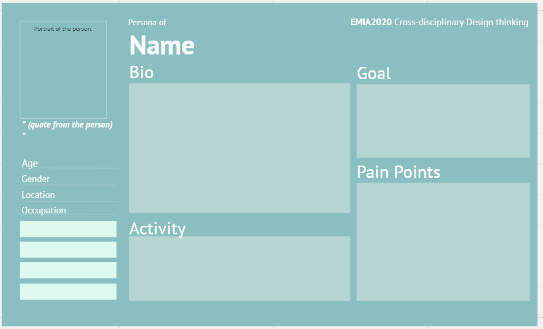

Assignment 1: To Understand - Observe and Interview
Part 3: Synthesis
Synthesis the information you obtain from your interview. Create personas (use the template here) for your target groups that you observed and interviewed.
Tips: Pay attention to the details, inconsistencies and nonverbal cues. What emotional or "latent" needs emerged? What pain points do they have? Move beyond the obvious and explicit to understand the more nuanced opportunities for design.
Alex
Alex is an undergraduate engineering student. He is majoring in Computer Science and he is a year 3 HKUST student now.
He loves to work with his laptop in the Engineering Common to do his programming things.
He is admitted to the university through JUPAS. He finished his secondary education in one of the secondary school in Hong Kong.
Alex wants to have some more time to study more different computer science elective courses, so that he can discover which area of computer science studies suit him the most, and hoping to find the suitable company to start his career once he graduates.
“I want more real-life practices.”
Around 20
Male
Hong Kong
Sometimes Alex finds out that the learning environment during the lectures are not ideal since the lectures contain almost no interaction between the student, which is bad for his learning experience.
Also, Alex would like to some programming concepts that are being widely used in the industry, but unfortunately the university courses do not teach the concepts much, and the hands-on practice is too little. This limits him from learning some commonly used coding technique in the companies.
Student
Loves making hands dirty
Introvert
- Watching anime
- Coding using C++
- Doing assignments
- Learning new things on the web
Hard-working
Busy
9

Slide 37
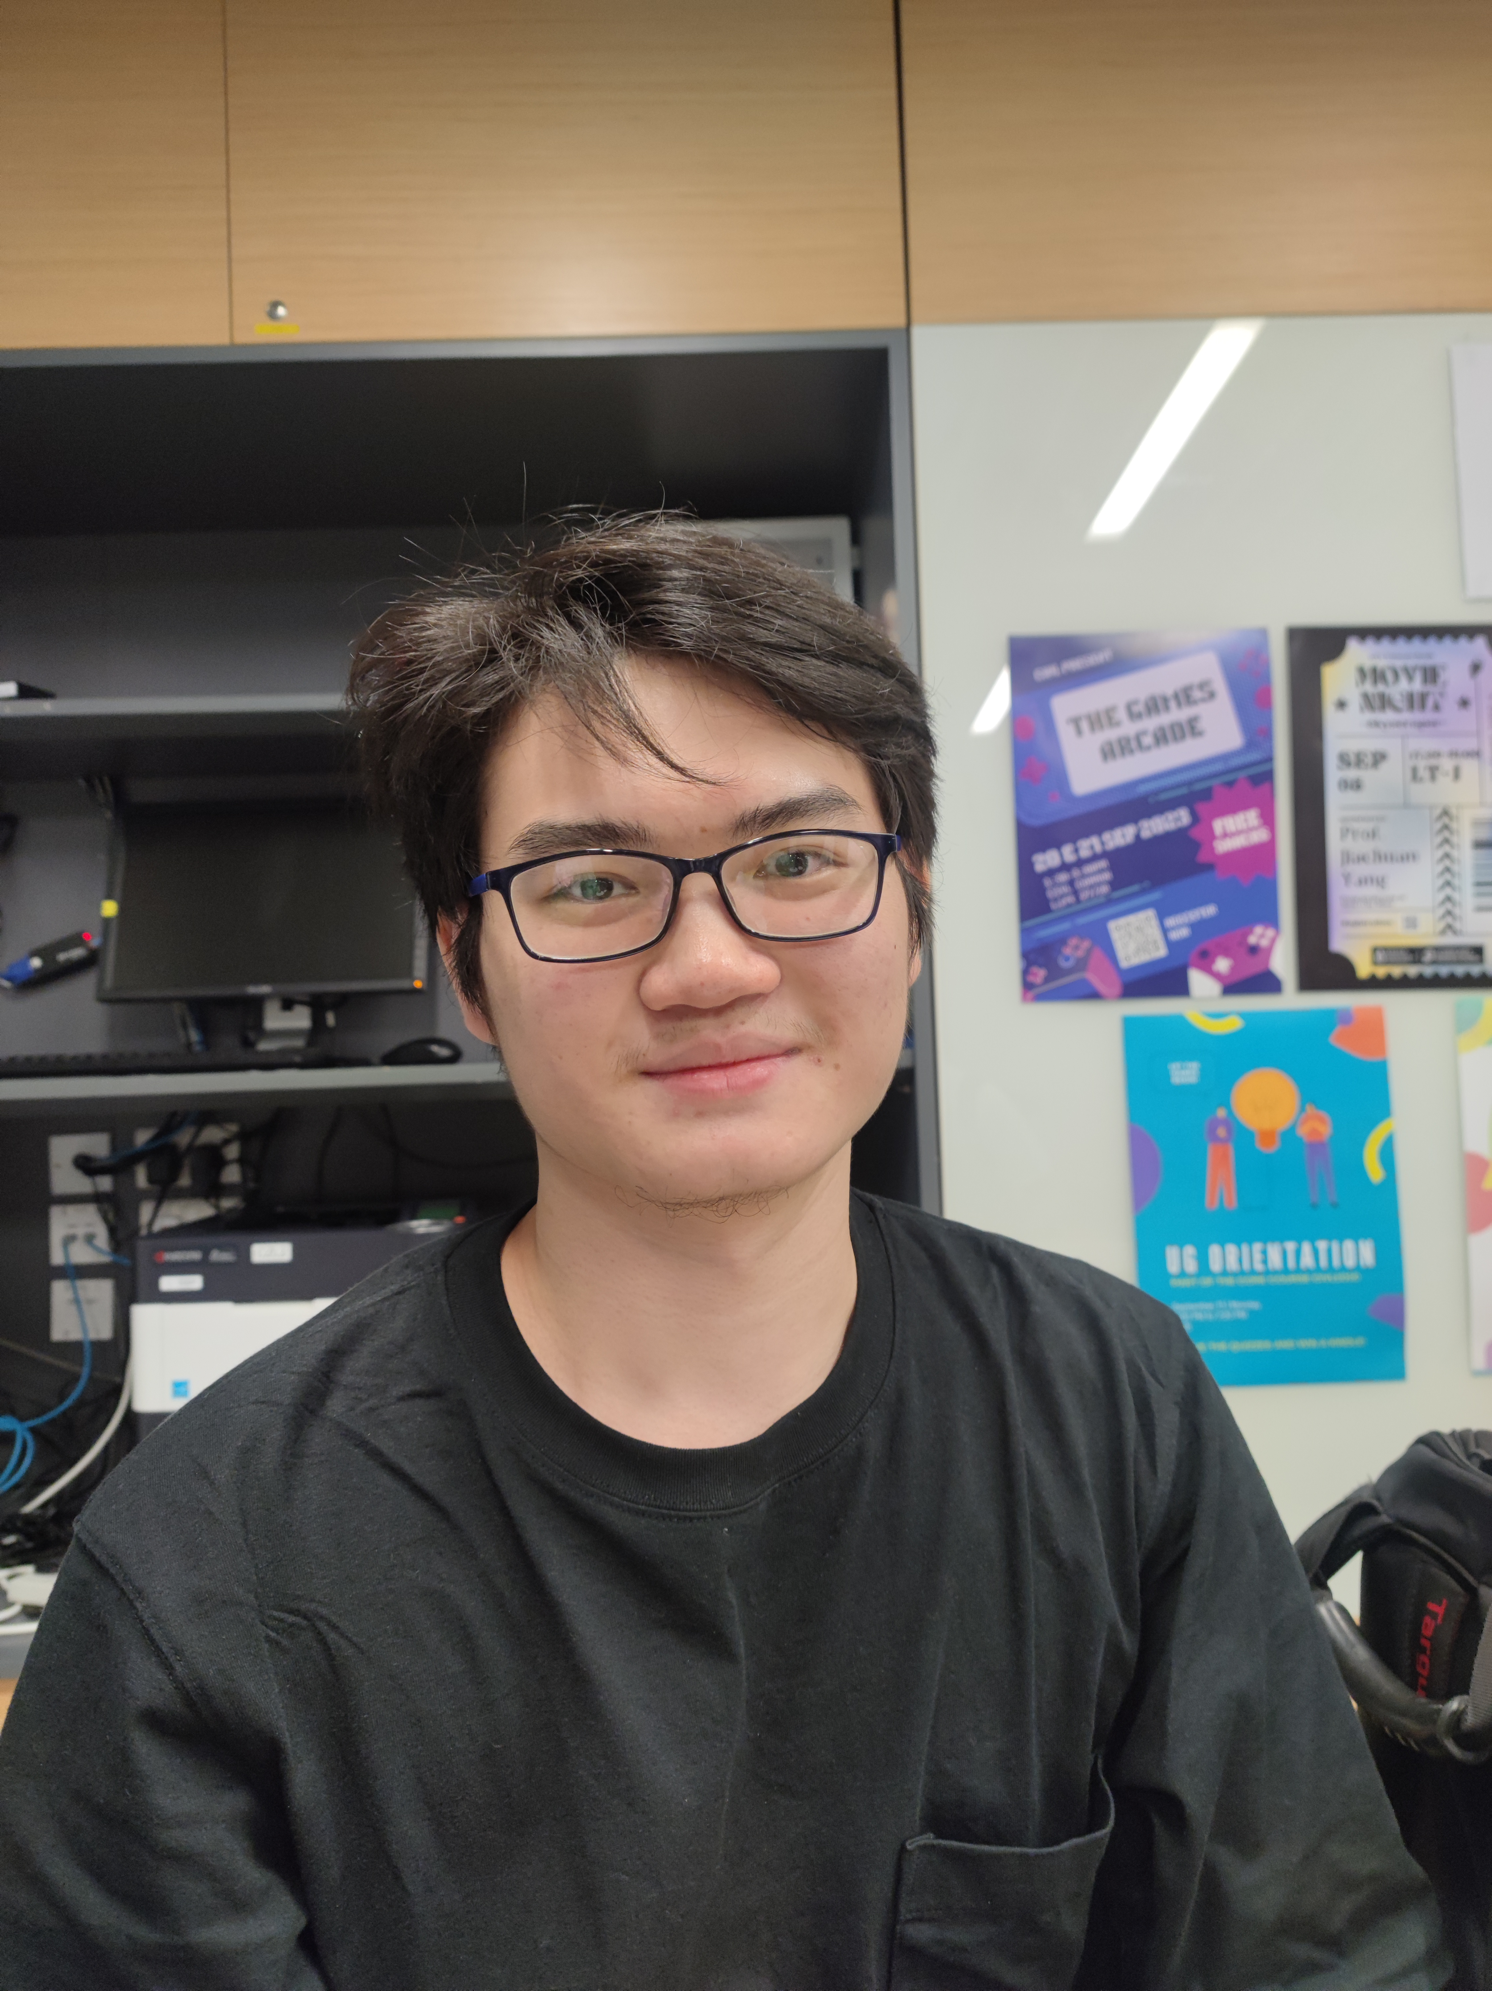
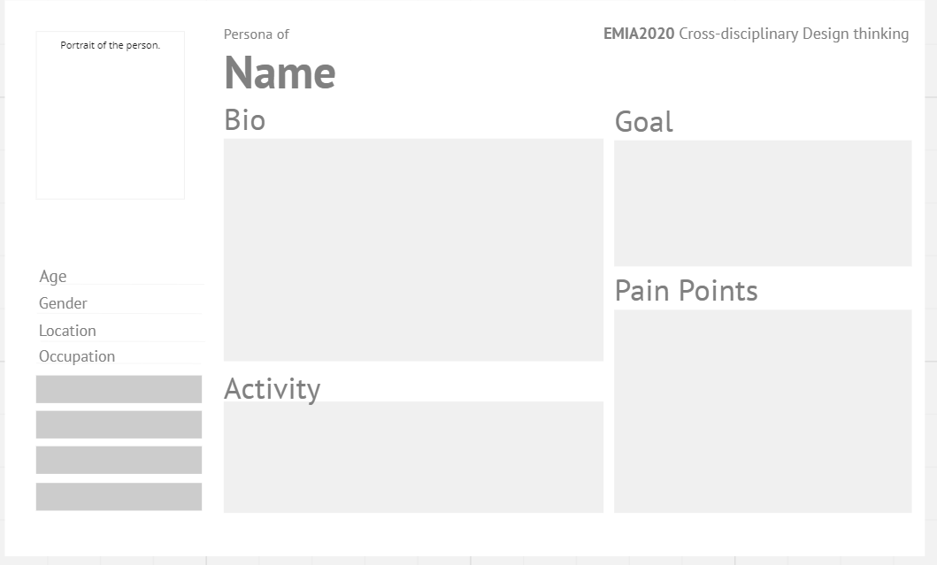
Assignment 1: To Understand - Observe and Interview
Part 3: Synthesis
Synthesis the information you obtain from your interview. Create personas (use the template here) for your target groups that you observed and interviewed.
Tips: Pay attention to the details, inconsistencies and nonverbal cues. What emotional or "latent" needs emerged? What pain points do they have? Move beyond the obvious and explicit to understand the more nuanced opportunities for design.
Mo
Mo is an engineering undergraduate students in HKUST. He is majoring in Civil Engineering, with an extended major in artificial intelligence. He is currently a Year 3 student.
He loves doing sports so much and he actively participate in some sports competition held by the Department of Civil and Environmental Engineering.
He is admitted to the university through JUPAS, and he finished his secondary school education in Hong Kong.
Mo is working very hard to finish his civil engineering degree, and he want to apply for the Scheme A and get the qualifications from HKIE once he graduate. He aims at becoming a civil engineer in the future.
“The university should organize more activities to encourage the professors interact more with the students.”
Around 20
Male
Hong Kong
Mo would like to participate more sports competitions held by his major department. Unfortunately, the competitions are always held near the midterm exams and final exams, which makes him hard to find some time to join them and interact more with the professors.
Also, he thinks that his major department does not offer enough resources for the new extended major track, which makes him hard to satisfy all requirements of the extended major path.
Student
Sporty
Energetic
- Play basketballs
- Play table tennis
- Running
- Go to gym
- Study in library
Hard-working
Relatively extrovert
9

